Slide 1
ICOM WLAN Radio System by NSTN
Call on NSTN.us 800-534-4456
Bob Burchett
Technical Project Manager

Slide 2
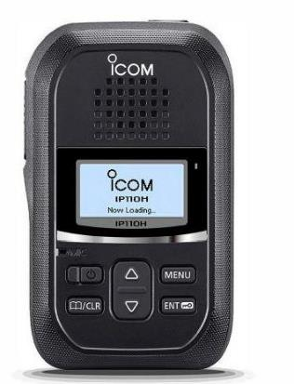
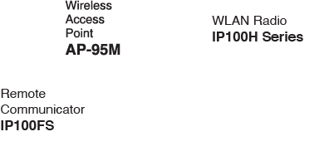
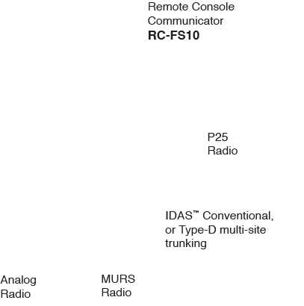
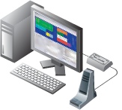
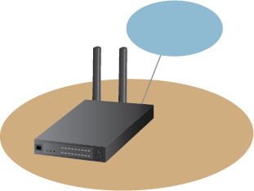
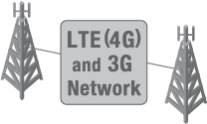
Communications Links

Slide 3
WLAN Radios
WLAN Radio
IP110H Series

Slide 4
Reasons to Select the WLAN System
There is no RF coverage in building
Cellular plan or recurring costs are too high
No budget for a new RF system
Cost of maintaining existing RF system is not feasible
Customers need a communications solution ASAP
Multi-site comms are required at a nominal cost
Customers want to purchase and own a cost effective communications solution
Existing LMR is not upgradeable or supported (Passport/LTR)
WLAN Radio
IP110H Series

Slide 5
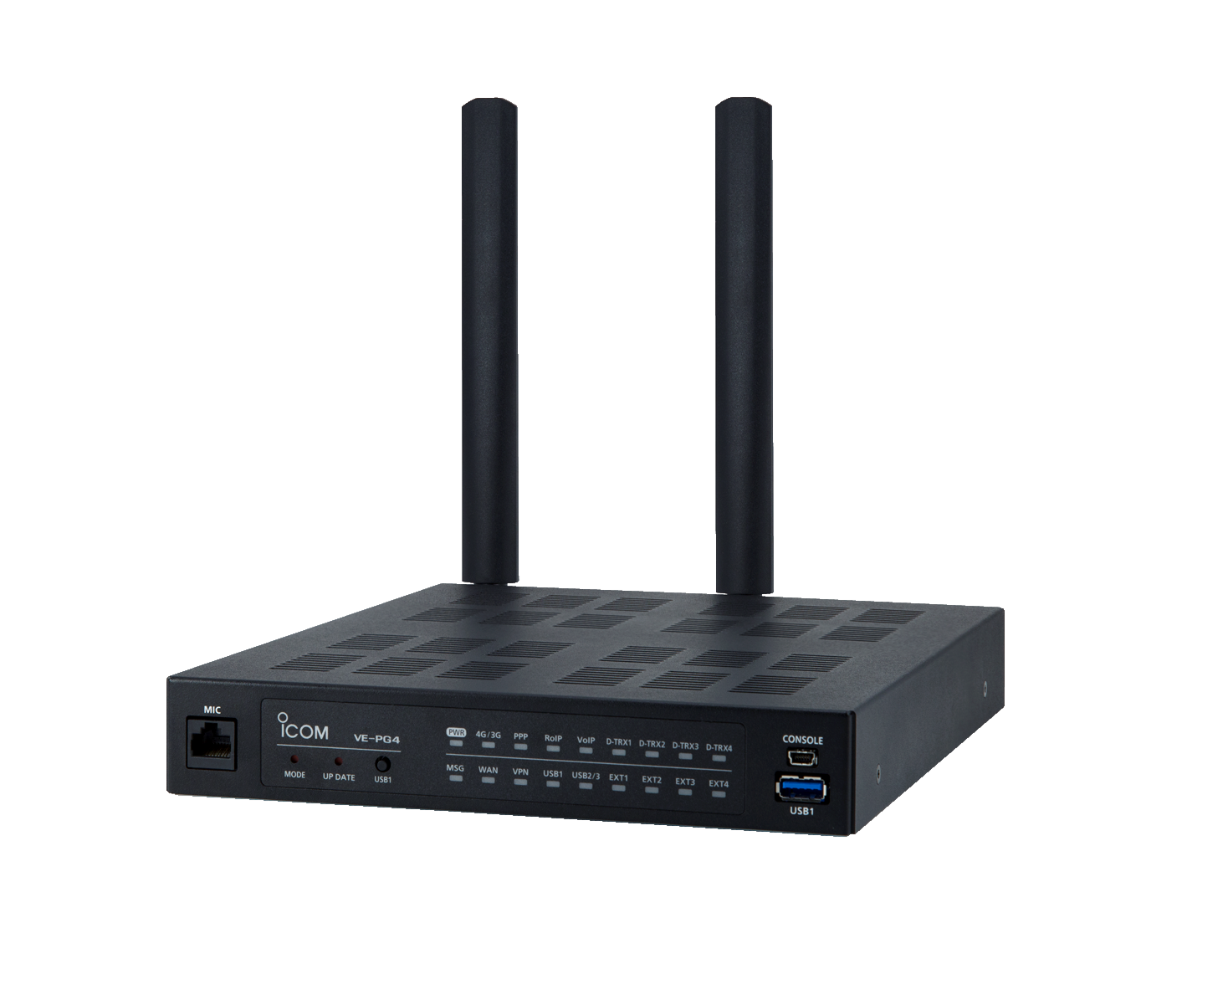
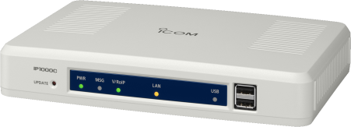
High Value Points
Cost versus traditional LMR radio systems
No Repeaters
No Licenses or Frequency Coordination
Can use existing WLAN and IP Infrastructure
Plug and Play-Installation can be completed in one day
Up to 1100- IP110H radios
Future-proof
NO COMPETITION- no other vendor has anything like this
Works for OUT-OF-THE-BOX communications solutions
Ease of use/operability- little or no training involved

Slide 6
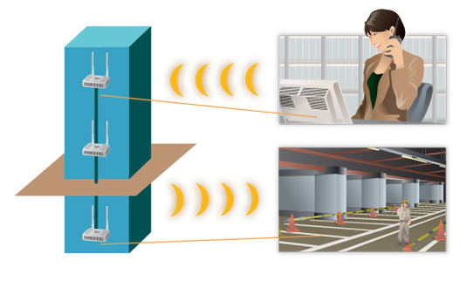
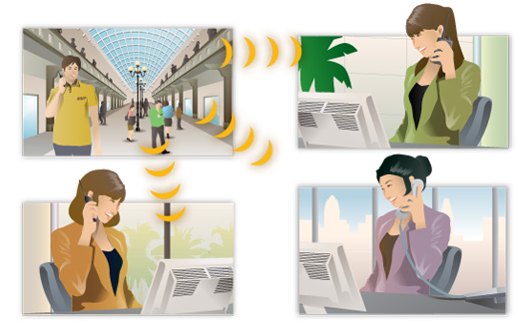
Benefits
No Site Costs
Range Testing is Simple
Easy to Expand over Different Locales
Coverage is Easily Expandable by adding Access Points.
PC Based Software Console- IP100FS for Dispatch by PC
Radio-like features such as Individual, Group Calls, All Calls
Encryption capable
System is Easily Managed with Bandwidth Requirements

Slide 7
What is WLAN
Wireless Local Area Network
A communications network that provides connectivity to wireless devices using WLAN technology.
A WLAN is the wireless equivalent of a hard-wired Ethernet network.
“ certified” products are WLAN products.
is a certified trademark of the “Wi-Fi Alliance”

Slide 8
Why WLAN?
INFRASTRUCTURE-
WLAN networks typically already existing in most businesses
MANAGEMENT-
The IT personnel can easily manage and maintain this system over their core network
COST-
It’s much cheaper than building out an RF system
DESIGN-
A standalone WLAN system can easily be constructed for customers with no existing network
TECHNOLOGY-
IP technology and networking is the future. Evolution of this product will grow with customers needs.

Slide 9
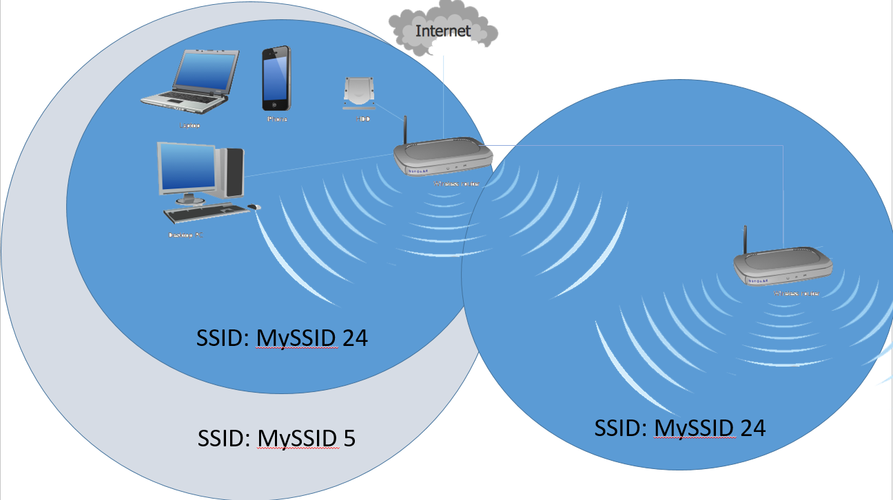
WLAN System Requirements
Need an IP1000C,IP1100CV, VE-PG4, or IP1500C Controller, Access Points, and IP110H handheld radios.
All units must have at least one of the 10 SSID and encryption setting entered in the radio configuration.
Access Point placement- Overlapping coverage and proper frequency use
Bandwidth
Simplex Voice Path= 150kbps per radio
Duplex Voice Path= 300kbps per radio

Slide 10
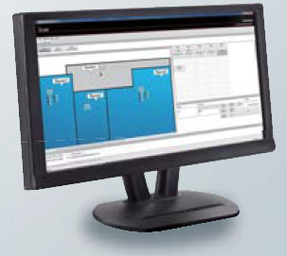
Benefits and Savings
Individual, Group Calls, All Calls
AES Encryption capabilities work on ALL high-end demand facilities
Bandwidth Requirements are easily managed
Installation can be completed very quickly
Up to 1100 radios with IP1000C, IP1100CV, or VE-PG4 combinations
Up to 1000 radios by default, and upgradable to 5000 with the IP1500C
Future-proof
Built-in Diagnostics and Range Testing
Easy to Expand over Different Locales
Coverage expandable just by adding Access Points
PC Based Software Console- IP100FS (OPTIONAL)

Slide 11
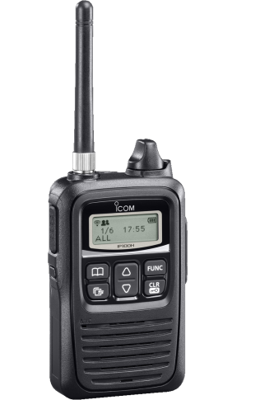
WLAN Radio System Components
IP100FS Remote Communicator
IP100H Radio
IP110H
Radio
IP1100CV Radio Controller
VE-PG4 RoIP Gateway
IP1000C Radio Controller

Slide 12
WLAN Radio System Components
IP100H Radio being replaced by IP110H
Internal/external antenna
Vibration alert for incoming calls
VOX capable with appropriate headset
Up to 27 hours with standard BP-271
Supports full duplex with headset connected, which allows many users in the system to transmit simultaneously.
Reliable sound quality
Sends status to the IP1000C and IP100FS
Provides a diagnostics mode to check:
TX & RX Mbps
Downlink signal strength
Mac address of the AP is using
SSID of the AP is logged on 12 characters
Channel the AP utilizes

Slide 13
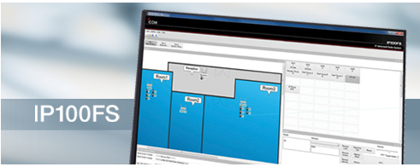
WLAN Radio System Components
IP100FS Remote Communicator
Is an IP-based PC-dispatcher and serves as an additional radio in your network.
Handles all types of calls
Individual
Group calls
Text messages.
Messages can be sent as free text or predefined.
Map feature that allows you to see which radio stations are connected to the respective access point.
Functions like a traditional radio in the system
Uses the computer's built-in sound system
Install in a Windows® based tablet or laptop PC
Monitor user status
Shows RX/TX call log

Slide 14
WLAN Radio System Components
IP1000C Radio Controller
The IP1000C is Icom’s wireless network system controller and keeps track of the radios in your network.
IP1000C can also communicate with third-party manufacturers' WLAN access points allowing for flexibility.
Manages up to 100 IP100H/IP100FS devices in a single network
Up to 11 IP1000C can be interconnected to increase total number of IP100H radios on a network
Can be used in all standard wireless networks
Manages Individual, Group, Talk Group, Multiplex TGs, Telephone calls, or all-area calls
DHCP Server capabilities
Supports simplex or full duplex
Supports wired equivalent privacy (WEP) and Wi-Fi protected access (WPA) encryption algorithms

Slide 15
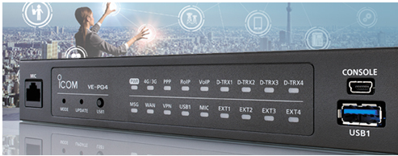
WLAN Radio System Components
VE-PG4 RoIP Gateway
The VE-PG4 allows you to bridge almost any modern communications system to ICOM’s universe of Network products and more.
Interconnect in a Variety of Ways: LTE PTT Products, Iridium SAT100 radios, LMR devices, and of course the IP100H, 110H, and 100FS devices.
Wireless LAN radio products controller built in
Support up to 50 IP100H radios
Icom IDAS conventional and trunking systems
Analog Radio Systems
P25 systems
DMR systems
SIP Phone

Slide 16
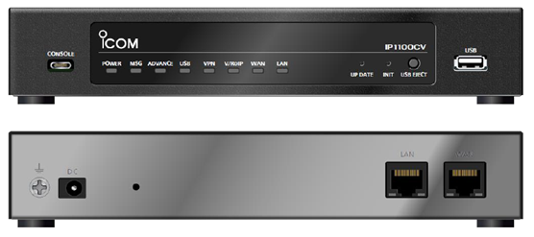
IP1100CV

Slide 17
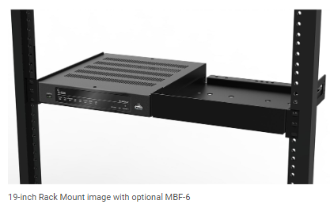
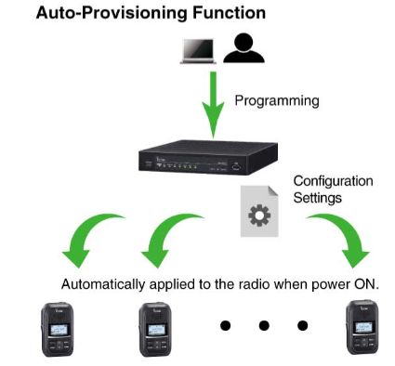
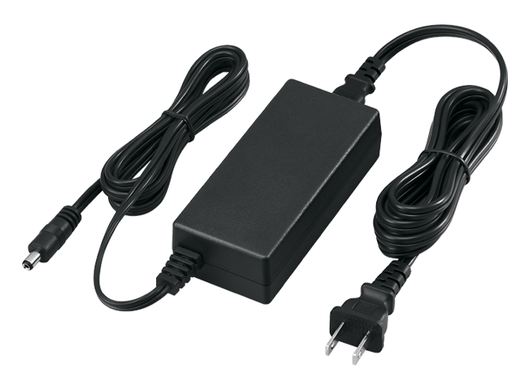
IP1100CV
Up to 300 WLAN can be registered including the IP100FS
Supports IP110H, and IP110H
Up to 500 Call addresses can be programmed
Can use a CSV file for easy manipulation of ID lists.
Auto provisioning of Radio terminals.
2.5 Gbps WAN port, and VPN Router Function.
This function is available between IP1100CV controllers, and between IP1100CV, and VE-PG4
Can be mount on a 19 inch rack utilizing the MBF-6 bracket
Easily programmed thru a web browser, and the configuration can be saved in a computer, or USB Fob.
Up to 10 more controllers can be linked to the IP1100CV, where there is a Master controller, and Subs.
Supports WPA-PSK32 Enterprise
Records up to 4 audio paths into a customer provided FOB
Uses the BC-207S power adapter, which is not included, and must be ordered separately

Slide 18
IP1100CV

Slide 19
Comparison

Slide 20
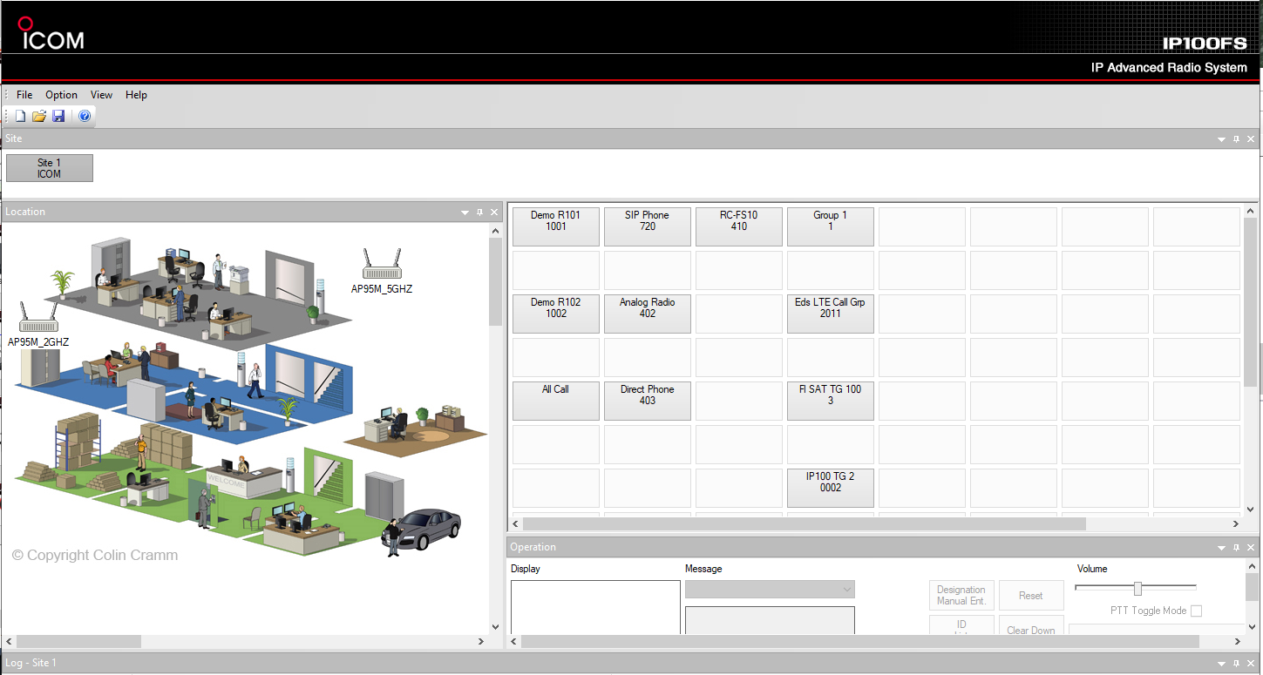
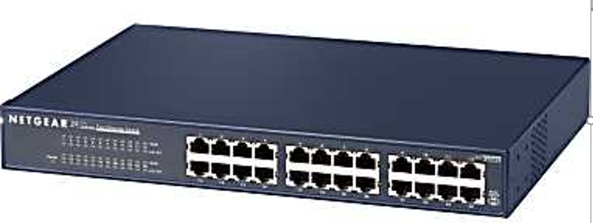
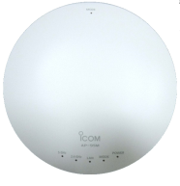
IP1100CV Network Connections
Network Connections
IP100FS
Switch/Router
Internet
Linked VE-PG4
AP95 AP
Linked IP1100CV
Linked IP1000C
IP110
IP110
IP110
Admin PC

Slide 21
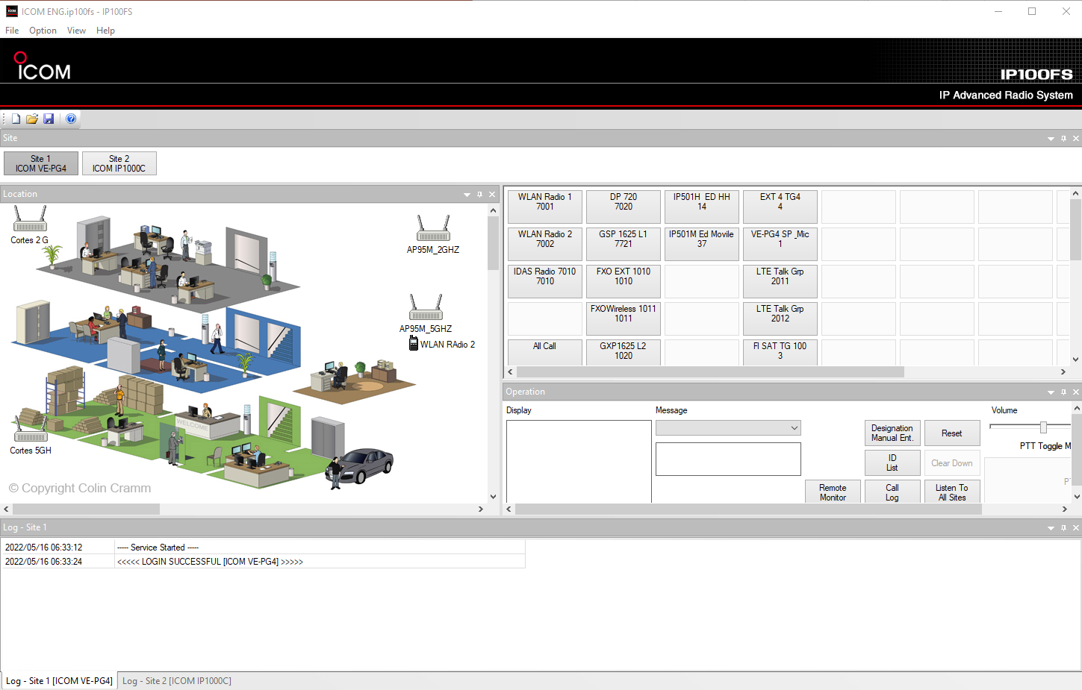
IP100FS Interface

Slide 22
SEE YOUR NSTN.US REP
New IP110H Now Available

Slide 23
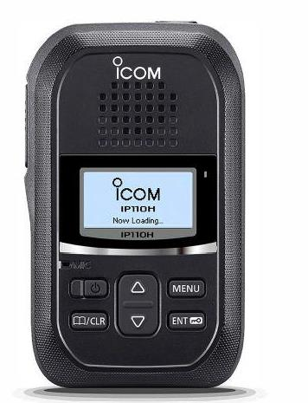
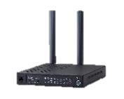
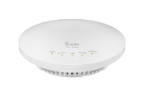
Wireless LAN transceiver IP110H
License-free and cost effective transceiver
covering the area within WLAN access points
Controller
WLAN access point
AP-95M
USA version comes with 11 channels (2.4 GHz band), 21 channels (5 GHz band)
 | 5GHz
 | UNII1 |  |  |  | UNII2A |  |  |  | UNII2C |  |  |  |  |  |  |  |  |  |  | UNII3
CH | 36 | 40 | 44 | 48 | 52 | 56 | 60 | 64 | 100 | 104 | 108 | 112 | 116 | 120 | 124 | 128 | 132 | 136 | 140 | 149 | 153 | 157 | 161 | 165
IP100H | X | X | X | X | X | X | X | X | X | X | X | X | X | X | X | X | X | X | X | - | - | - | - | -
IP110H | X | X | X | X | X | X | X | X | X | X | X | X | X | - | - | - | X | X | X | X | X | X | X | X
New WLAN transceiver
IP110H
In IP110H, 120/124/128CH can no longer be used in order to comply with Canadian regulation.

Slide 24
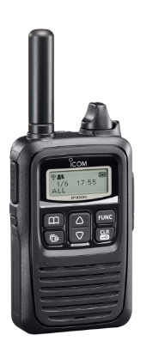
Visit NSTN.us for more!
MAN DOWN
COMPACT
USER FRIENDLY
INTERFACE
New WLAN transceiver
IP110H
IP100H

Slide 25
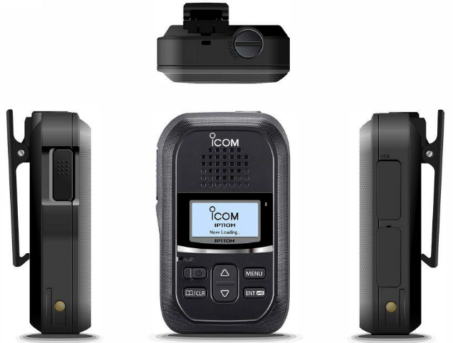
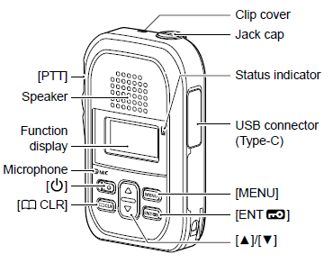
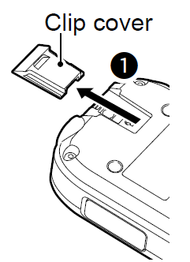
Exterior and Supplied Accessories
Supplied accessories
USB charging cable*
Belt clip (MBB-1)
*No AC adapter supplied

Slide 26
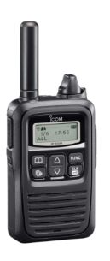
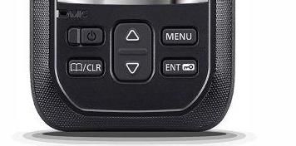
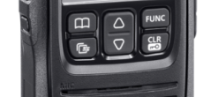
Power and Volume Switch
PWR/VOL knob
VOL UP/DOWN
PWR button
IP100H
IP110H
*Volume level adjustment = 0 to 32
Same as IP100H

Slide 27
New Functions and Features

Slide 28
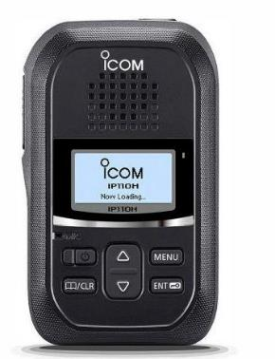
Audio Enhancement
IP100H IP110H
400mW
1,000mW
LOUDER AND CLEARER

Slide 29
Screen Size Improvement
IP100H IP110H
H:12mm / W:30mm H:15mm / W:29mm
Clearer information at your hand!!!

Slide 30
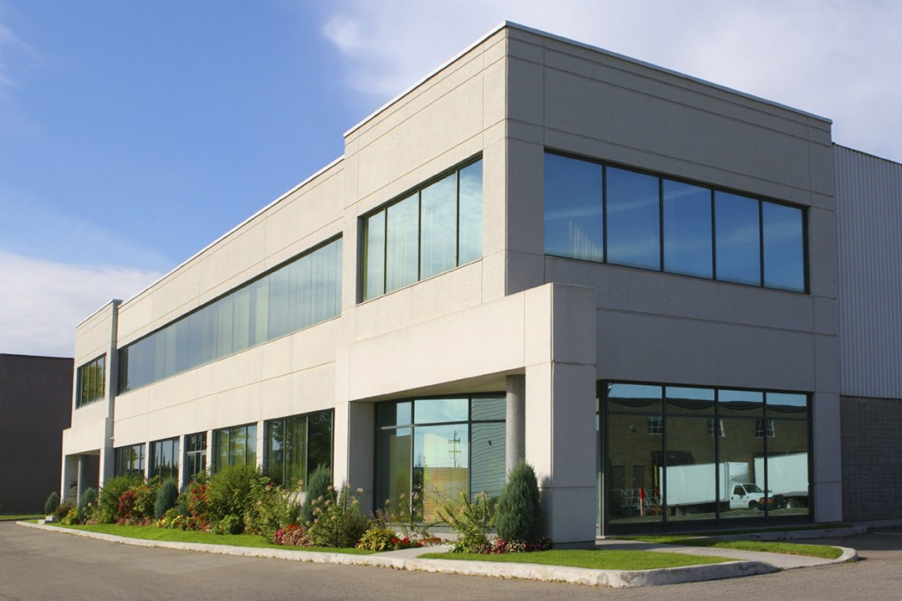
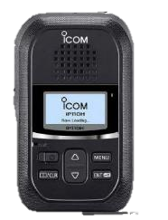
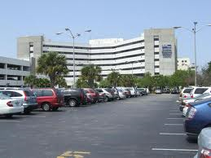
WPA2 Enterprise
Required by Government agencies, Hospitals, and Universities
RADIUS
IP110H : WPA2 Enterprise
(Server Authentication)
IP100H
WPA/WPA2-PSK/WPA-PSK
(Passphrase Authentication)
*RADIUS server is required for this function

Slide 31
NSTN.US IS YOUR SUPPLIER

Slide 32
Simultaneous Talk Listen (Full duplex)

Slide 33
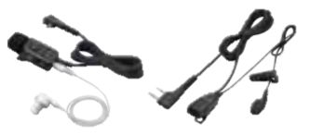
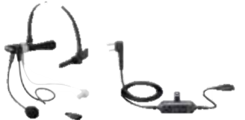
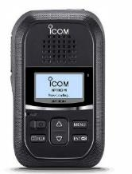
Simultaneous TalkListen (Full duplex)
NO HEADSETS REQUIRED

Slide 34
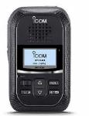
Advantage of simultaneous talk listen function
Emergency!

Slide 35
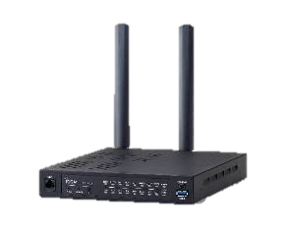
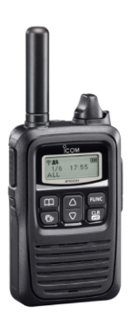
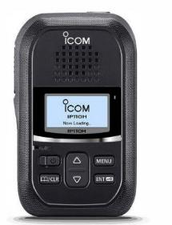
Phone Book Memory increased to 500
VE-PG4 ROUTER
IP100H
500 entries
50 entries
IP110H
*When IP1000C used as a controller, the phone book memory limit is 50 entries

Slide 36
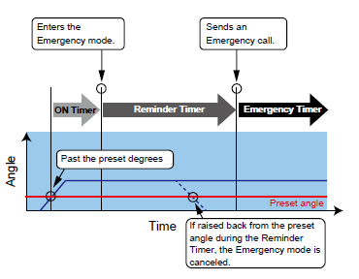
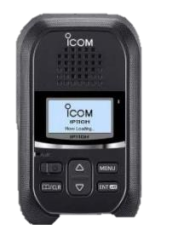
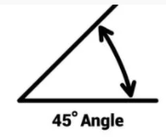
Man Down Alerting
EMERGENCY !!!
*configurable by software

Slide 37
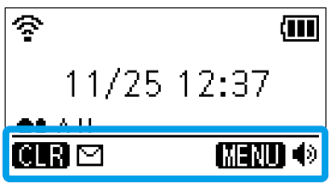
2 Programmable Keys
Press
1 sec
<Programmable Functions>
Message
One Touch
*to select the frequent call destination or call type
Clear Down
Mute
Emergency
Playback Recording
Temporary Audio Level
P2
P1

Slide 38
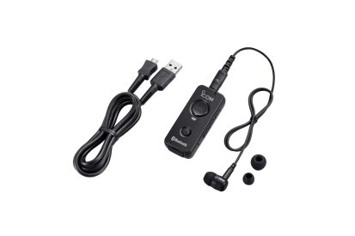
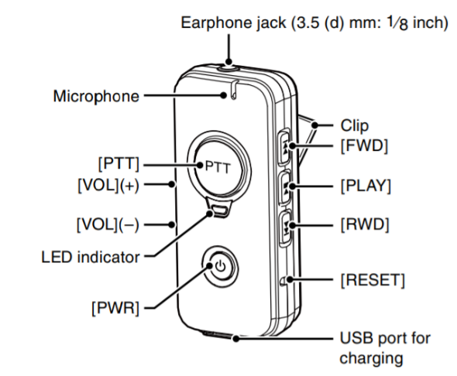
Bluetooth Capability
＋
IP110H
VS-3
Bluetooth Specification
- Frequency range: 2402 ~ 2480 MHz
- Transmission power: Class 2
- Version 4.2
- Profile: HFP, HSP
3 ADDITIONAL PROGRAMMABLE KEYS with the use of the VS-3 microphone
[FWD](P3), [PLAY](P4), [RWD](P5)

Slide 39
Temporary Audio Level Switch
On RX
+10 Volume UP
Construction
Airport
Sports event
Concert venue
Festival etc..
P2
Example
P1
Reception
Meeting room
Library
Theatre
Wedding etc..
-10 Volume DOWN
*Volume comes back to original level once RX ends

Slide 40
Customization of Startup Screen
Settings Menu on Controller
IA Radio
Now Loading
*Maximum of 8 upper/lower-case letters
including space

Slide 41
Other Features
One Touch PTT (Hands-free operation)
Keep PTT on by pressing [PTT] switch / undo it by pressing [PTT] again.
Recording
Record the received call until it ends. A total of 4 mins or a maximum of 10 recordings, whichever is greater.
Care Charge
Keep the battery capacity in 60-70% while charged. This will prolong the usable life of the batteries
Minimum Volume Preset
Able to program the minimum volume level (”0” by default).
Vibration
Vibrates when receiving a call depending on the Controller setting.
Alert
Notify when you are out of the Wi-Fi area depending on the Controller setting.

Slide 42
Basic Specifications in comparison with IP100H
 | IP100H | IP110H
Wireless Standards | IEEE 802.11 a/b/g/n | IEEE802.11 a/b/g/n/ac
Dimensions (W×H×D) | 58×95×26.4mm (with Battery) | 57 × 96.9 × 25.1 mm *Built-in Battery
Weight (approx.) | 205g (with Battery and Antenna) | 146g *Built-in Battery and Antenna
IP Rating | IPX7 | IP67 / IP54
AF Output Power | 400mW typ. (Internal SP) 200mW typ. (External SP) | 1000 mW typ. (Internal SP) 300 mW typ. (External SP)
Security | WEP (64/128-bit), WPA-PSK (TKIP/AES), WPA2-PSK (TKIP/AES) | WEP (64/128-bit), WPA2-Enterprise, WPA-Enterprise, WPA-PSK, WPA2-PSK
LIGHT AND COMPACT
BUT
TOUGH AND RUGGED

Slide 43
Functions in comparison with IP100H

Slide 44
Basic System Example with IP110H
IP1000C**
or
IP1500C
*USB dongle
VE-PG4
IP1100CV
Wireless AP
AP-95M
**IP1000C affects the functions
Phone book limit 50 at max
WLAN and certificate settings are configurable only by CS-IP110H with WPA/WPA2

Slide 45
Controllers
 | VE-PG4 | IP1000C | IP1500C
Terminal Capacity | 50 | 100 *Links up to 11 IP1000C via IP network | 1000 *Expandable up to 5000 with additional license
Supply Form | Hardware Half size of a 19-inch rack | Hardware | USB dongle *With Server requirement
Dimension | 213 × 36.8 × 270 mm *antenna excluded | 232×38×168mm | ---
Weight | 1.8 kgs | 750 grams | ---
Price Level | Middle | Low | High
RoIP Gateway | YES | NO | NO
Phone Book Limit on IP110H | 500 | 50 | 500
Microphone Connection | YES | NO | NO
IP110CV
300 *Links up to 11 IP1100CV via IP network
Hardware Half size of a 19-inch rack
213×36.8×242mm
1.5 kg
middle
NO
500
NO

Slide 46
System Example Expanding the existing system
VE-PG4
IP1500C
*USB dongle
IP1100CV
IP1000C
or
Wireless AP
AP-95M
Connectable
IP100H
on existing system
IP110H
additionally installed
**IP1000C will impact some the functionality
Phone book limit 50 at max

Slide 47
System Example Remote Communications via VPN
Area A
VPN
Controller
VE-PG4
Area B
main office

Slide 48
Options
Earphone Mic
Headset
HM-179PI
OPC-2133
HS-94
HS-95
HS-97
＋
Speaker Mic
HM-186PI
Compact speaker mic
HM-228
Waterproof(IP67)

Slide 49
See Your NSTN Rep!
HM-153LS
HM-186LS
HM-179PI
HM-186PI

Slide 50
USB Connections

Slide 51
CS-IP110H #21 software

Slide 52
Charging
USB charger
Charged with cradle
BC-257（up to 4 units connectable）
USB cable
*Supplied ACC
＋
AC adapter
*User supplied
＋
BC-228
BC-257 + USB cable in one pair
＋
USB cable
*Supplied ACC

Slide 53
IP100FS Remote Dispatcher
Remote communicator
Display image
Shows the Status of eachIP110H
Creates up to 120 shortcut buttons to make various types of calls
Shows received and transmitted call logs
Shows the alia name of the IP110H using the access point
Wireless AP
AP-95M
Desktop mic
IP100FS dongle

Slide 54
Visit www.NSTN.us for MORE !

